Slide 1
Temporal
Data Models
Fabio Grandi
fabio.grandi@unibo.it
DISI, Università di Bologna

Slide 2
Temporal Data Models
Data model: DM = (DS, QL)
  DS is a set of data structures
  QL is a language for querying and updating the data structures
Example: the relational data model is composed of relations and SQL (or relational algebra)
Many extensions of the relational data model to support time have been proposed

Slide 3
Temporal Data Models
Several modeling aspects have to be considered
  Different Time dimensions
  Different Timestamp types
  Tuple versus Attribute timestamping
  (Ungrouped versus Grouped model?)
  Point-based versus Period-based model
  (Atelic versus Telic data?)
The different modeling aspects lead to subtle and difficult issues. There are pros and cons in all cases (no consensus can be reached)

Slide 4
Time Dimensions
Time in a TDB is multi-dimensional:
  valid time, transaction time, event/decision time, publication time, efficacy time, “user-defined” time
Different time dimensions are of practical interest in different application fields
The key question is: which time aspects are sufficiently important so that they should be supported by the database system?
There is a broad consensus that transaction time and valid time are the most important time dimensions

Slide 5
Valid Time
Valid time is the time a fact was/is/will be true in the modeled reality or mini-world
  A fact is a statement that is either true or false
  A relation is a collection of facts
  Example: John has been hired on October 1, 2014
  Valid time captures the time-varying states of the mini-world
  All facts have a valid time by definition, however, it might not be recoreded in the database
  Valid time is independent of the recording of the fact in a database
  Valid time is either bounded (does not extend until infinity) or unbounded (extends until infinity)
  Future facts can be represented (stated or forecasted)

Slide 6
Transaction Time
Transaction time is the time when a fact is current/present in the database as stored data
  Example: the fact “John was hired on October 1, 2014” was stored in the DB on October 5, 2014, and has been deleted on March 31, 2015
  Transaction time has a duration: from insertion to deletion, with multiple insertions and deletions being possible for the same fact
  With transaction time deletions of facts are purely logical
    the fact remains in the database, but ceases to be part of the database current state.
  Transaction time captures the time-varying states of the database
  Always bounded on both ends
    Starts when the database is created (nothing was stored before)
    Does not extend past now (no facts are known to have been stored in the future)
  Basis for supporting accountability and “traceability” requirements, e.g. in financial, medical, legal applications
  Should be supplied and managed automatically by the DBMS

Slide 7
Dimensions of Time
A data model can support none, one, two, or more of these time dimensions
  Snapshot data model: None of the time dimensions is supported
    Represents a single snapshot of the reality and the database
  Valid time data model: Supports only valid time
  Transaction time data model: Supports only transaction time
  Bitemporal data model: Supports valid time and transaction time
In a former terminology [Snodgrass & Ahn 1986]:
  Historical DB → valid-time DB
  Rollback DB → transaction-time DB
  Temporal DB → bitemporal DB
A DB where snapshot, transaction-time, valid-time and bitemporal relations coexist can be called a multi-temporal database

Slide 8
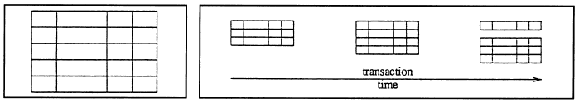
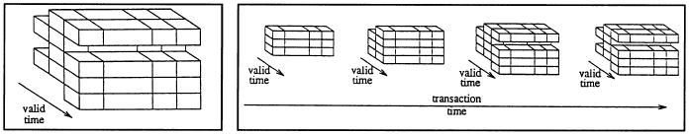
Temporal Relations
A pictorial representation of the 4 kinds of temporal table and evolution along the time axes
  snapshot table transaction-time table
  valid-time table bitemporal table

Slide 9
Dimensions of Time
Which time dimensions are needed by an application?
(what can be done and what cannot be done?)
Consider the following example involving the career of an employee:
1. John was hired as a programmer (PRG)
with initial salary 2000 at time 1;
2. John’s salary was raised to 3000 at time 3
(but recorded in the DB at time 4);
3. John became a database administrator (DBA)
at time 6.
Notice that 2. involves a retroactive update

Slide 10
In a Transaction-time DB
1. John was hired as a programmer (PRG)
with initial salary 2000 at time 1;
2. John’s salary was raised to 3000 at time 3
(but recorded in the DB at time 4);
3. John became a database administrator (DBA)
at time 6.
Emp
The time of the change 2. is incorrectly represented
Name | Job | Salary | TT
John | PRG | 2000 | [1,3]
John | PRG | 3000 | [4,5]
John | DBA | 3000 | [6,Now]
Name | Job | Salary | TT
John | PRG | 2000 | [1,3]
John | PRG | 3000 | [4,Now]
Name | Job | Salary | TT
John | PRG | 2000 | [1,Now]

Slide 11
In a Valid-time DB
1. John was hired as a programmer (PRG)
with initial salary 2000 at time 1;
2. John’s salary was raised to 3000 at time 3
(but recorded in the DB at time 4);
3. John became a database administrator (DBA)
at time 6.
Emp
The validity of changes is correctly represented but
there is no way to know that change 2. was retroactive
Name | Job | Salary | VT
John | PRG | 2000 | [1,2]
John | PRG | 3000 | [3,Now]
Name | Job | Salary | VT
John | PRG | 2000 | [1,Now]
Name | Job | Salary | VT
John | PRG | 2000 | [1,2]
John | PRG | 3000 | [3,5]
John | DBA | 3000 | [6,Now]

Slide 12
In a Bitemporal DB
1. John was hired as a programmer (PRG)
with initial salary 2000 at time 1;
2. John’s salary was raised to 3000 at time 3
(but recorded in the DB at time 4);
3. John became a database administrator (DBA)
at time 6.
1
3
corner under the diagonal
(i.e. VT.Start < TT.Start): retroactive transaction
6
VT
1
PRG, 2000
4
PRG, 3000
6
DBA, 3000
TT

Slide 13
In a Bitemporal DB
1. John was hired as a programmer (PRG)
with initial salary 2000 at time 1;
2. John’s salary was raised to 3000 at time 3
(but recorded in the DB at time 4);
3. John became a database administrator (DBA)
at time 6.
Emp
Name | Job | Salary | TT | VT
John | PRG | 2000 | [1,3] | [1,Now]
John | PRG | 2000 | [4,Now] | [1,2]
John | PRG | 3000 | [4,5] | [3,Now]
John | PRG | 3000 | [6,Now] | [3,5]
John | DBA | 3000 | [6,Now] | [6,Now]
Name | Job | Salary | TT | VT
John | PRG | 2000 | [1,Now] | [1,Now]
Name | Job | Salary | TT | VT
John | PRG | 2000 | [1,3] | [1,Now]
John | PRG | 2000 | [4,Now] | [1,2]
John | PRG | 3000 | [4,Now] | [3,Now]

Slide 14
Choice of Temporal Dimensions
A Transaction-time DB allows user to only effect immediate (on-time) transactions; proactive transactions are physically impossible and retroactive transactions store data histories with a wrong “validity”
A Valid-time DB allows users to execute retro-/pro-active transactions (validity of modifications aka applicability period is expressed by users via the DML); after its execution, there is no way to know whether a transaction was immediate or retro/pro-active
A Bitemporal DB allows users to execute retro-/proactive transactions and to keep track of their execution in the DB

Slide 15
Other Time Dimensions
Event Time [Chakravarthy & Kim 94] aka
Decision Time [Nascimento & Eich 95]
Considering the event E causing the change of some data with some validity (in the mini-world and in the DB):
  E occurs at time T in the mini-world (Decision/Event Time)
  E occurs at time Tꞌ ≥ T in the DB (Transaction Time)
E/D-T vs VT (=,<,>): current, futuristic, past due
TT vs VT (=,<,>): immediate, proactive, retroactive
E/D-T vs TT (=,<,>): instantaneous, late, N/A
In specific application domains, other time dimensions can be of interest (e.g. Efficacy time in the legal field)

Slide 16
Event vs State Temporal Relations
Moreover, in a TDB there can be two kinds of temporal relations:
  Event tables, with instant timestamps
  (store information about facts without duration)
  State tables, with period or element timestamps
Event table are suitable to store measures, sensor data, departure/transit/arrival times
  Departures
  Departures
Flight | Time
100 | 2015-08-01 12:30
55 | 2015-09-10 11:15
256 | 2016-01-01 16:40

Slide 17
Temporal Relations
In the following, we focus on state tables
An implicit continuity assumption is often done
(data values as produced by an insertion or update are assumed to persist until they are changed or deleted, e.g. salary of an employee)
  Emp
Name | Dept | Salary | Time
Tom | SE | 2300 | [1/1/12, 1/1/16)
Ann | DB | 3200 | [1/1/10, 1/1/15)
Ann | DB | 3400 | [1/1/15, Now]

Slide 18
Timestamping
A timestamp is a value that is associated with data in a database
  Captures some temporal aspect, e.g. valid time, transaction time
  Represented as one or more attributes/columns of a relation
Three different types of timestamps are widely used
  Time points
  Time periods
  Temporal elements
Two different ways of timestamping
  Tuple timestamping
  Attribute timestamping
Temporally grouped models are not based on timestamping (but adopt a functional approach similar to attribute timestamping though)

Slide 19
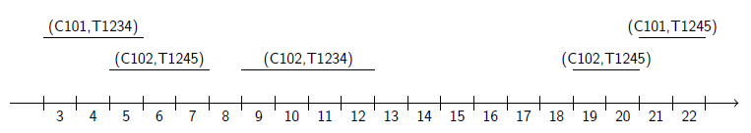
Timestamping
Example: Videogame store where customers, identified by a CustID, rent videogames, identified by a GameNo. Consider the following rentals during May 2015:
  On 3rd of May, customer C101 rents game G1234 for three days
  On 5th of May, customer C102 rents game G1245 for 3 days
  From 9th to 12th of May, customer C102 rents game G1234
  From 19th to 20th of May, and again from 21st to 22nd of May, customer C102 rents game G1245
These rentals are stored in a relation CheckOut which is graphically illustrated below
(C101, G1234) (C102, G1245)
(C102, G1245) (C102, G1234) (C102, G1245)

Slide 20
Tuple Timestamping with Points
CustID | GameNo | Time
C101 | G1234 | 3
C101 | G1234 | 4
C101 | G1234 | 5
C102 | G1245 | 5
C102 | G1245 | 6
C102 | G1245 | 7
C102 | G1234 | 9
C102 | G1234 | 10
C102 | G1234 | 11
C102 | G1234 | 12
C102 | G1245 | 19
C102 | G1245 | 20
C102 | G1245 | 21
C102 | G1245 | 22
Point-based data model:
each tuple is timestamped
with a time point/instant
  Most basic and simple data model
  Timestamps are atomic values that
  can be easily compared, using
  =, <>, >, <, >=, <=
  Multiple tuples are used if a fact is
  valid at several time points
  Syntactically different relations store
  different information
  Provides an abstract view of a DB
  and is not meant for physical
  implementation
  Conceptual simplicity and
  computational complexity make it
  popular for theoretical studies

Slide 21
Tuple Timestamping with Points
Rental | CustID | GameNo | Time
R1 | C101 | G1234 | 3
R1 | C101 | G1234 | 4
R1 | C101 | G1234 | 5
R2 | C102 | G1245 | 5
R2 | C102 | G1245 | 6
R2 | C102 | G1245 | 7
R3 | C102 | G1234 | 9
R3 | C102 | G1234 | 10
R3 | C102 | G1234 | 11
R3 | C102 | G1234 | 12
R4 | C102 | G1245 | 19
R4 | C102 | G1245 | 20
R5 | C102 | G1245 | 21
R5 | C102 | G1245 | 22
The reconstruction of the
original relation is not always
possible
The table on the previous slide
makes it impossible to
determine if C102 rented
G1245 once or twice in the
period from 19 to 22
Additional attributes are
required, e.g. Rental to
represent the individual rentals
It is difficult to predict when an
additional attribute is needed

Slide 22
Tuple Timestamping with Periods
Period-based (interval-based) data model:
each tuple is timestamped with a time period
CheckOut
Timestamps are atomic values that can be compared using Allen’s 13 basic relationships between periods (before, meets, during, etc.)
  More convenient than comparing the endpoints of the periods
  The benefits of Allen’s predicates are relatively small
CustID | GameNo | Time
C101 | G1234 | [3,5]
C102 | G1245 | [5,7]
C102 | G1234 | [9,12]
C102 | G1245 | [19,20]
C102 | G1245 | [21,22]

Slide 23
Tuple Timestamping with Periods
  The start and end of an interval are distinguished change points
  The Rental attribute is not needed to distinguish different
  checkouts
  Multiple tuples are used if a fact is valid over disjoint time periods
  Cannot model a single checkout with a gap
  The most popular model from an implementation perspective (even in SQL89, with two columns Start, End)
  Time periods are not closed under all set operations
    Ex. subtracting [5, 7] from [1, 9] returns a set of periods
    { [1, 4], [8, 9] }

Slide 24
Tuple Timestamping with Temporal Elements
Data model with temporal elements:
each tuple is timestamped with a temporal element,
that is a finite set of time periods
CheckOut CheckOut
The full history of a fact is stored in one tuple
Usually the periods of a temporal element must be disjoint and non-adjacent (i.e. element = union of maximal disjoint periods). This makes it similar to point timestamps
CustID | GameNo | Time
C101 | G1234 | { [3,5] }
C102 | G1245 | { [5,7], [19,22] }
C102 | G1234 | { [9,12] }
CustID | GameNo | Time
C101 | G1234 | [3,5]
C102 | G1245 | [5,7] U [19,22]
C102 | G1234 | [9,12]

Slide 25
Attribute Timestamping
Attribute value timestamping: each attribute value is timestamped with a set of time points/periods
All information about a real-world object is captured in a single tuple
  e.g. all information about a customer in a tuple of the relation below; each tuple is timestamped with a temporal element,
  that is a finite set/union of time periods
CheckOut
CustID | Rental | GameNo
C101 { [3,5] } | R1 { [3,5] } | G1234 { [3,5] }
C102 { [5,7], [9,12], [19,22] } | R2 { [5,7] } R3 { [9,12] } R4 { [19,20] } R5 { [21,22] } | G1245 { [5,7], [19,22] } G1234 { [9,12] }

Slide 26
Attribute Timestamping
Notice that a single tuple may record multiple facts
  e.g. the second tuple records the following facts: rental information for customer C102 for the games G1245 and G1234, and four different checkouts
CheckOut
Non-first-normal-form (N1NF) data model
In a previous terminology:
  Homogeneous model → tuple timestamping
  Inhomogeneous model → attribute timestamping
CustID | Rental | GameNo
C101 { [3,5] } | R1 { [3,5] } | G1234 { [3,5] }
C102 { [5,7], [9,12], [19,22] } | R2 { [5,7] } R3 { [9,12] } R4 { [19,20] } R5 { [21,22] } | G1245 { [5,7], [19,22] } G1234 { [9,12] }

Slide 27
Attribute Timestamping
Different groupings of the information into tuples are possible for attribute-value timestamping
  Information about other objects is spread across several tuples (e.g. information about videogames)
  e.g. regrouping the CheckOut table on GameNo in the example below
CheckOut
  (such an operation is, in general, problematic!)
CustID | Rental | GameNo
C101 { [3,5] } C102 { [9,12] } | R1 { [3,5] } R3 { [9,12] } | G1234 { [3,5], [9,12] }
C102 { [5,7], [19,22] } | R2 { [5,7] } R4 { [19,20] } R5 { [21,22] } | G1245 { [5,7], [19,22] }

Slide 28
Temporally Grouped Model
  In a temporally grouped (or history-oriented) data model
    the temporal dimension is implicit in the structure of data representation
    data objects are substituted by their histories (ID not necessary)
    attributes can be regarded as partial functions that map time into data domains
  Temporal models based on addition of timestamping columns can be considered ungrouped
Rental | CustID | GameNo
R1 | { [3,5] } → C101 | { [3,5] } → G1234
R2 | { [5,7] } → C102 | { [5,7] } → G1245
R3 | { [9,12] } → C102 | { [9,12] } → G1234
R4 | { [19,20] } → C102 | { [19,20] } → G1245
R5 | { [21,22] } → C102 | { [21,22] } → G1245

Slide 29
Temporally Grouped Model
  A temporally grouped model is strictly more expressive than an ungrouped data model
    Ex. If we project the CheckOut relation on CustID:
  A temporally grouped model is difficult to implement
    History IDs (e.g. surrogates) are needed to represent grouped data in a 1NF relation
    Operations (e.g. join) are problematic to define with HIDs
    A N1NF (e.g. XML) database would be needed
CustID
{ [3,5] } → C101
{ [5,7] } → C102
{ [9,12] } → C102
{ [19,20] } → C102
{ [21,22] } → C102
We still know that such tuples involve 5 different rentals: the last two tuples do not merge as they belong to different groups (i.e. checkouts)
In an ungrouped models the last two tuples can be coalesced and we lose such information

Slide 30
Point- versus Period-based Data Model
  In a point-based data model, truth value of facts is associated to time points
  Tuple timestamping with periods (or elements) can be used as a compact representation or normalization tool
    Adjacent or overlapping value-equivalent tuples can be coalesced to obtain a canonical representation
  A fact true in [S,E] is true at any instant t∈[S,E]
  In a period-based (or interval-based) data model, period timestamps are first-class objects and truth value of facts can be associated to whole time periods

Slide 31
Period-based Data Model
  In a weak interpretation, period timestamps are first-class objects
  Although the truth value of facts is point-based,
  it is important to preserve (e.g. for lineage/provenance management) the individuality of period boundaries through operations, as they are reminiscent of change events (initiation and termination)
    Ex. promotion or retirement for salary changes
  In a strong interpretation, period timestamps are used to represent telic facts

Slide 32
Atelic versus Telic Temporal Data
  Atelic data is temporal data that describe facts that do not involve a goal or culmination (e.g. have a job, salary)
  Atelic data enjoy the downward and upward inheritance properties
    Downward inheritance: fact valid in period T is also valid in any subset of T (and at any instant of T)
    Upward inheritance: a fact valid in consecutive or overlapping periods T1 and T2 is also valid in T1 U T2
  Telic data are temporal data for which downward and upward inheritance properties do not hold
  Telic data represent accomplishments or achievements
  Examples of telic facts:
    the Golden Gate bridge was built from January 1933 to April 1937
    John had a phleboclysis of 500mg of drug X from 10:30 to 11:45

Slide 33
The Bitemporal Conceptual Data Model
  The goal of the Bitemporal Conceptual Data Model (BCDM) is to capture the essential semantics of time-varying relations
    The BCDM is not intended for presentation, storage, or query evaluation purposes
    The goal of the BCDM is similar to the goal of abstract temporal databases
    Chomicki [2009] proposed the notions of abstract and concrete temporal databases to separate semantics and representation
  Semantics associated with periods is not possible in the BCDM (it is a point-based data model)

Slide 34
The Bitemporal Conceptual Data Model
  Bitemporal Conceptual Data Model (BCDM)
    Supports valid time and transaction time
    Both time domains are linear and discrete
      Valid-time domain: D_{VT} = { t₁, t₂, …, t_{k} }
      Transaction-time domain: D_{TT} = { tꞌ₁, tꞌ₂, …, tꞌ_{j} } U {now}
    A bitemporal chronon is a pair of a transaction-time chronon and a valid-time chronon
      (t_{i} , t_{j}) ∈ D_{TT} x D_{VT}
      "tiny rectangle" in the two-dimensional space
    A bitemporal element is a set of bitemporal chronons
    Timestamp attribute T with domain of bitemporal elements
    Explicit (non-timestamp) attributes
      Names: D_{A} = { A₁, A₂, …, A_{n} }
    BCDM schema: (A₁, A₂, …, A_{n},T)
    BCDM tuple: (a₁, a₂, …, a_{n}, t_{b})
    Value-equivalent tuples (tuples with identical explicit attributes) are not allowed
      the full history of a fact is contained in a single tuple

Slide 35
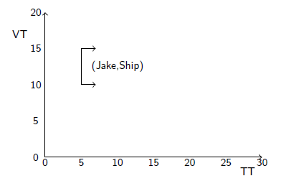
The Bitemporal Conceptual Data Model
  Example: Consider a relation recording empolyee/department information
    Employee Jake was hired in the shipping department for the period from time 10 to time 15
    This fact became current in the database at time 5
    Arrows indicate that the tuple has not been deleted yet

Slide 36
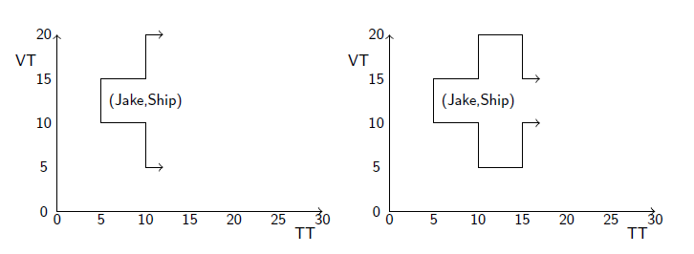
The Bitemporal Conceptual Data Model
  Example (contd.)
    The personnel office discovers that Jake had really been hired from time 5 to time 20
    The database is corrected beginning at time 10
    Later on at time 15 the HR department has been informed that the original time was correct

Slide 37
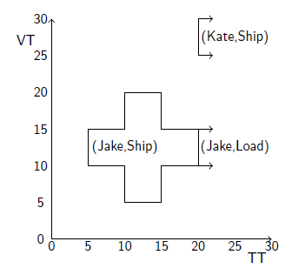
The Bitemporal Conceptual Data Model
  Example (contd.) At time point 19 the following updates are performed (updates shall become effective at time 20):
    Jake was not in the shipping department, but in the loading department
      The fact (Jake,Ship) is removed from the current state, and the fact (Jake,Load) is inserted
    A new employee Kate is hired for the shipping department for the time from 25 to 30

Slide 38
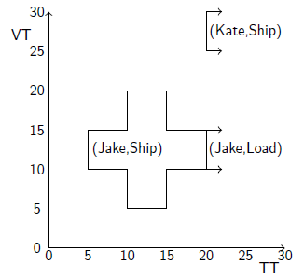
The Bitemporal Conceptual Data Model
  After the updates the bitemporal relation contains 3 facts and is given below
  dept
Emp Dept | T
Jake Ship | {(5,10),…,(5,15),…,(9,10),…,(9,15), (10,5),…,(10,20),…,(14,5),…,(14,20), (15,10),…,(15,15),…,(19,10),…,(19,15)}
Jake Load | {(now,10),…,(now,15)}
Kate Ship | {(now,25),…,(now,30)}

Slide 39
Updates in the BCDM
  Update operations
    New facts with a given valid timestamp are inserted to a relation with now as transaction time chronon
    As time passes by, the bitemporal elements associated with current facts are updated
    Facts are (logically) deleted by removing the chronons containing now

Slide 40
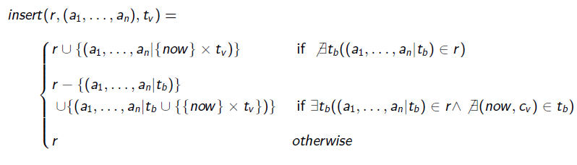
Updates in the BCDM
  Insert: Record in a relation r a currently unrecorded fact (a₁, a₂, …, a_{n}) with validity t_{v}
  Three cases are distinguished:
    If (a₁, a₂, …, a_{n}) was never recorded, a new tuple is appended
    If (a₁, a₂, …, a_{n}) was part of some previously current state, the tuple recording is updated
    If (a₁, a₂, …, a_{n}) is already current in the database, a modification is required (and the insertion is rejected)

Slide 41
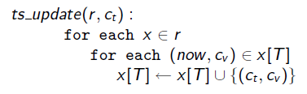
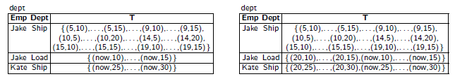
Updates in the BCDM
  ts_update: Special routine to add new chronons as time goes by
    Applied to all bitemporal relations at each clock tick
    Updates the timestamps to include the new transaction-time value
    Each bitemporal chronon with a transaction time of now produces an appended bitemporal chronon with now replaced with the current transaction time
    Example: Department relation at time 19 and 20

Slide 42
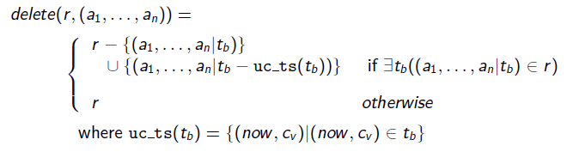
Updates in the BCDM
  Delete: Logical removal of a tuple from the current valid-time state
    Delete all chronons (now, c_{v}) from the timestamp of the tuple
    (c_{v} is some valid-time chronon)
    The timestamp is not expanded by subsequent invocations of ts_update, and the tuple will not appear in future valid-time states
Modify: Modification of a current tuple

Slide 43
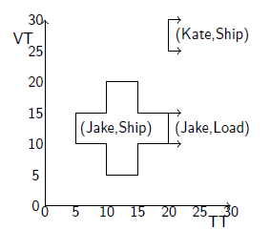
Updates in the BCDM
Example: The istance of the department relation dept is created by the following sequence of commands
Operation | TT
insert(dept, ("Jake","Ship"), [10,15]) | 5
modify(dept, ("Jake","Ship"), [5,20]) | 10
modify(dept, ("Jake","Ship"), [10,15]) | 15
delete(dept, ("Jake","Ship")) | 20
insert(dept, ("Jake","Load"), [10,15]) | 20
insert(dept, ("Kate","Ship"), [25,30]) | 20

Slide 44
Concrete Temporal Data Models
  The abstract Bitemporal Conceptual Data Model needs conversion into a representational or concrete temporal data model to be implemented in a DBMS
  The BCDM is a unifying framework for studying and comparing different temporal data models
  Mappings have been provided for most of the concrete temporal data models proposed in the literature

Slide 45
Tuple Timestamped Model [Snodgrass]
  Supports valid time and transaction time
  Adds four atomic-valued attributes to each relation
    Start and end point of the valid time: Vs ,Ve
    Start and end point of the transaction time: Ts ,Te
  Schema: R = (A1, . . . , An, Ts ,Te ,Vs ,Ve)
  Timestamping attributes Ts, Te, Vs, Ve have been also called differently (e.g. In, Out, From, To, respectively)
  Ts, Te (Vs, Ve, resp.) represent the endpoints of a transaction (valid, resp.) time period, which is usually considered open to the right
  Hence Ts ,Te ,Vs ,Ve represent the bitemporal chronons (a bitemporal chronon is a two-dimensional time point)
  of the corresponding rectangular region [Ts,Te) x [Vs,Ve)
  1NF relations

Slide 46
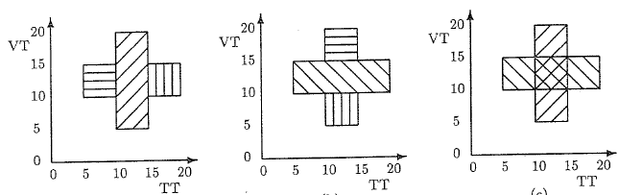
Tuple Timestamped Model
  A closed region in a two dimensional space (TT x VT) must be represented by a set of rectangles
    any bitemporal chronon in x.T is contained in at least one rectangle
    each bitemporal chronon in a rectangle is contained in x.T
  Various coverings of a 2D area are possible:
    Overlapping versus non-overlapping rectangles
    Partitioning by transaction time versus partitioning by valid time
  Partitioning by TT (VT) yields maximal segments in VT (TT) direction

Slide 47
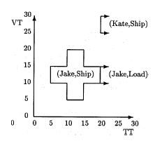
Tuple Timestamped Model
  Example: Department relation in the tuple timestamped data model, using partitioning by transaction time
  dept
  Once the partitioning criterion has been chosen, a unique mapping from the BCDM is defined
Emp | Dept | Ts | Te | Vs | Ve
Jake | Ship | 5 | 10 | 10 | 15
Jake | Ship | 10 | 15 | 5 | 20
Jake | Ship | 15 | 20 | 10 | 15
Jake | Load | 20 | Now | 10 | 15
Kate | Ship | 20 | Now | 25 | 30

Slide 48
Backlog-based Data Model [Jensen]
  Supports valid time and transaction time
  Adds four atomic-valued attributes to each relation
    Start and end point of the valid time (Vs ,Ve)
    Transaction time when the tuple was inserted into the backlog (T)
    An operation which is either insert or delete (Op)
  Schema: R = (A1, . . . , An, Vs ,Ve ,T, Op)
  Tuples in backlogs are never updated, i.e. backlogs are append-only 1NF relations
  The fact in an insertion request is current starting at the transaction’s timestamp and until a matching delete request is recorded
  T is the commit time of the transaction executing Op

Slide 49
Backlog-based Data Model
  Example: Department relation in the backlog-based data model
  dept
  Implicitly does partitioning by TT in mapping from the BCDM
Emp | Dept | Ts | Te | T | Op
Jake | Ship | 10 | 15 | 5 | I
Jake | Ship | 10 | 15 | 10 | D
Jake | Ship | 5 | 20 | 10 | I
Jake | Ship | 5 | 20 | 15 | D
Jake | Ship | 10 | 15 | 15 | I
Jake | Ship | 10 | 15 | 20 | D
Jake | Load | 10 | 15 | 20 | I
Kate | Ship | 25 | 30 | 20 | I

Slide 50
Attribute Timestamped Data Model [Gadia]
  Supports valid time and transaction time
  Schema:
  R = ({(TT1 x VT1, A1)}, . . . , {(TTn x VTn, An)})
  A tuple is composed of n sets
    Each set element is composed of a bitemporal period
    (e.g. [Ts,Te) x [Vs,Ve) ) and an attribute value
  N1NF relations (e.g. suitable to OODB or XML)
  A relation might be restructured (regrouped) on different attributes
    For example, group by department rather than employee yields facts for each department

Slide 51
Attribute Timestamped Data Model
  Example: Department relation in the attribute timestamped data model
  dept
Emp | Dept
[5,10) × [10,15) Jake [10,15) × [5,20) Jake [15,20) × [10,15) Jake [20,Now) × [10,15) Jake | [5,10) × [10,15) Ship [10,15) × [5,20) Ship [15,20) × [10,15) Ship [20,Now) × [10,15) Load
[20,Now) × [25,30) Kate | [20,Now) × [25,30) Ship

Slide 52
Attribute Timestamped Data Model
  Temporal elements can also be used as timestamps
  dept
  The mapping from the BCDM is univocally defined once we have chosen the form of the periods (e.g. closed or open to the right)
Emp | Dept
{ [5,10) × [10,15), Jake [10,15) × [5,20), [15,20) × [10,15), [20,Now) × [10,15) } | { [5,10) × [10,15), Ship [10,15) × [5,20), [15,20) × [10,15) } { [20,Now) × [10,15) } Load
{ [20,Now) × [25,30) } Kate | { [20,Now) × [25,30) } Ship

