Slide 1
Temporal Query Languages
Fabio Grandi
fabio.grandi@unibo.it
DISI, Università di Bologna

Slide 2
Temporal Query Languages
Data model: DM = (DS, QL)
DS is a set of data structures
QL is a language for querying and updating the data structures
Example: the relational data model is composed of relations and SQL (or relational algebra)
Many extensions of the relational data model and SQL to support time have been proposed

Slide 3
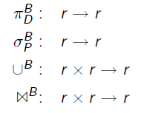
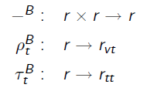
Relational Algebra for the BCDM
An algebra provides a procedural/operational language for a data structure that is suitable for implementation
Algebra for the standard relational algebra operators in BCDM
Schema: R = (A₁, …, A_{n}, T)
Domains: A_{i} has domain D_{i} and T has domain P(D_{TT} x D_{VT} )
D_{TT} is the transaction-time domain and D_{VT} is the valid-time domain
r is an instance relations of schema R
The operators then have the following signature

Slide 4
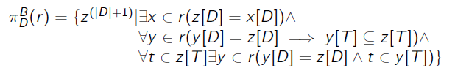

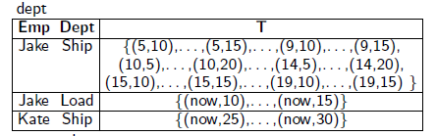
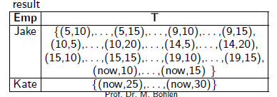
Projection in BCDM
Temporal projection: Project a relation r with non-timestamp attributes A₁, …, A_{n} to a subset D of attributes
Calculation of timestamps of result tuples
All chronons in any value-equivalent tuple of r must be included and no spurious chronons can be introduced
(automatic coalescence is performed)
Ex. Projection on the Emp attribute:

Slide 5


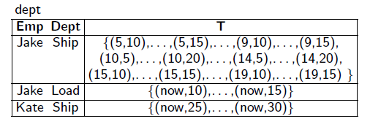

Selection in BCDM
Temporal selection: Select from relation r with non-timestamp attributes A₁, …, A_{n} all tuples that satisfy a predicate P defined on the non-timestamp attributes
Ex. Select all tuples of employee Kate:

Slide 6

Union in BCDM
Temporal union: Compute the union of tuples from two relations r₁ and r₂ that are instances of the same schema (or union-compatible schemas)
The first clause handles value-equivalent tuples found in r₁ and r₂
The second (third) clause handles those tuples that are found only in r₁ (r₂)

Slide 7
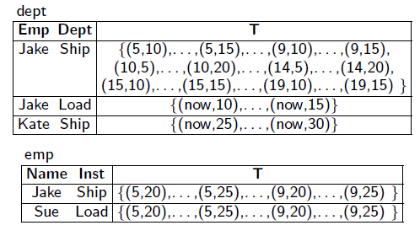

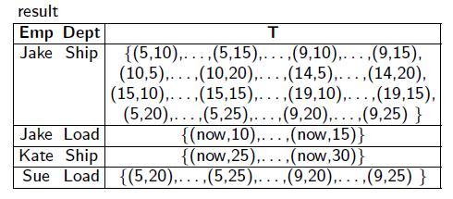
Union in BCDM
Ex. Compute the union of relations dept and emp:

Slide 8
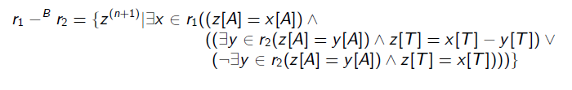
Difference in BCDM
Temporal difference: Compute those tuples that are in r₁ and not in r₂ where the two relations are instances of the same schema (or union-compatible schemas)
The last two lines compute the bitemporal element, depending on whether a value-equivalent tuple may be found in r₂ or not

Slide 9
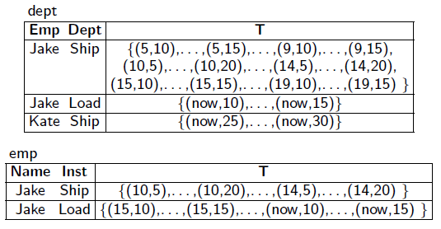

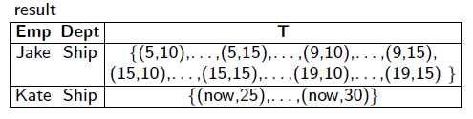
Difference in BCDM
Ex. Compute the difference of relations dept and emp:

Slide 10
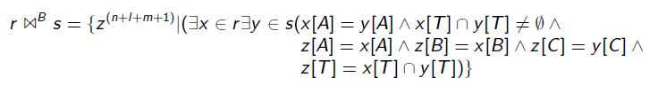
Join in BCDM
Temporal join: Two tuples join if they match on the join attributes A₁, …, A_{n} and have overlapping bitemporal-element timestamps
r and s are instances over the following schemas:
R(A₁, …, A_{n}, B₁, …, B_{l}, T) = R(A, B, T)
S(A₁, …, A_{n}, C₁, …, C_{m}, T) = S(A, C, T)
The timestamp of a result tuple is the intersection of the timestamps of the corresponding argument tuples

Slide 11

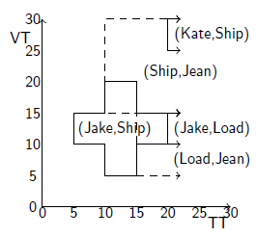
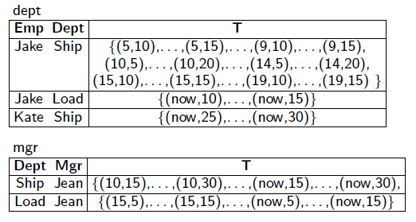
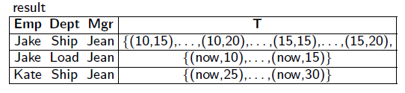
Join in BCDM
Ex. Temporal join to compute “Who managed whom”?:
The timestamp is the overlap of timestamp regions of tuples with matching join attribute

Slide 12
Timeslice Operators in BCDM
Transaction-timeslice operator: selects the relation at transaction time t₁ (not exceeding the current time)
Takes a bitemporal relation r as input and returns a valid-time relation
Valid-timeslice operator: selects the relation at valid time t₂
Takes a bitemporal relation r as input and returns a transaction-time relation

Slide 13
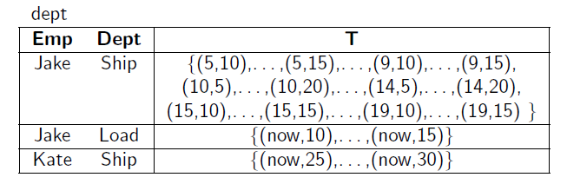
Timeslice Operators in BCDM
Timeslice operators can be extended for transaction-time and valid-time relations
ρ^{T} gets as input a transaction-time relation and returns a snapshot relation
τ^{V} gets as input a valid-time relation and returns a snapshot relation
Ex.
τ^{B}₁₂ (dept) = { (Jake,Ship, {5,…,19}), (Jake,Load, {now}) }
ρ^{V}₇ ( τ^{B}₁₂ (dept) ) = { (Jake,Ship) }

Slide 14
Sequenced Semantics
There is a close relationship between a temporal and a non-temporal database:
the snapshot of a temporal relation at a time t is a non-temporal relation
a temporal relation is a collection of timestamped snapshots
All non-temporal statements can be evaluated at each snapshot of a temporal database (“at each time point”)
There should be a close relationship between a temporal and a non-temporal statement:
e.g. a temporal aggregation should resemble a non-temporal aggregation
With SQL this is not the case (remember temporal join versus join)…

Slide 15
Sequenced Semantics
Notations (we assume R is a valid-time relation):
Relation schema: R(A₁, ..., A_{n}, T_{S}, T_{E} )
r is a relation with schema R (instance of R)
A₁, ..., A_{n} are the explicit (non-temporal) attributes
T_{S}, T_{E} are temporal attributes
T_{S} is the valid time start
T_{E} is the valid time end
z^{(n+2)} denotes a tuple of arity n+2
We assume periods are half open intervals [T_{S},T_{E} )
We write T to refer to the period [T_{S},T_{E} )
t ∈ T ≡ T_{S} ≤ t < T_{E}

Slide 16

Sequenced Semantics
Notations:
The timeslice operator τ maps a temporal to a non-temporal relation
Definition of the timeslice operator:
τ_{t}(r) = { z^{(n)} | ∃x ∈ r (z.A = x.A /\ x.T_{S} ≤ t < x.T_{E} ) }
Two temporal relations, r and s, are snapshot equivalent iff for all times t their snapshots are identical
Definition of snapshot equivalence:

Slide 17

Sequenced Semantics
Snapshot reducibility reduces the semantics of temporal operators to the semantics of the corresponding non-temporal operators
temporal operator ψ^{T} is snapshot-reducible to the non-temporal operator ψ iff for all t:

Slide 18

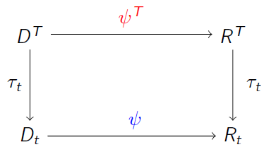
Sequenced Semantics
D^{T} = temporal DB
ψ^{T} = {σ^{T}, π^{T}, θ^{T}, x^{T}, U^{T}, -^{T}}
R^{T} = temporal result relation
τ_{t} = snapshot at time point t
D_{t} = snapshot of D^{T} at time t
ψ = {σ, π, θ, x, U, -}
R_{t} = result relation at time t
Illustration of snapshot
Reducibility:

Slide 19
Sequenced Semantics
A temporal relation can be viewed as made up of a sequence of timestamped snapshot relations
Mutual consistency of the two viewpoints along the time axis gives rise to the notion of snapshot reducibility
If period/element timestamping is adopted, timestamps of the argument tuples are taken into account when forming the timestamp associated to the result tuples (e.g. intersection is used when executing a join)
Enforcement of snapshot reducibility gives rise to a sequenced semantics (i.e. “at each time point”) in query execution [Böhlen, Jensen, Snodgrass]

Slide 20
Non-Sequenced Semantics
Snapshot reducibility does not apply to queries involving predicates and functions over the timestamps of argument relations
In such queries, snapshots valid at different times have to be mixed in in order to find the answer
Hence, their evaluation requires a non-sequenced semantics
Such queries give the full temporal expressivity to a temporal query language (and fully exploits the power of a temporal database)
Ex. Find the employees who were programmer before becoming DBA
The information about being programmer and about being DBA must be found by combining (with a join) different snapshots

Slide 21
Beyond Sequenced Semantics [Böhlen]
Period-based semantics (even in a weak sense) requires the preservation of the individual timestamp periods through the application of operators
Extended snapshot reducibility allows non-sequenced queries to be executed with a sequenced semantics
It can be enforced via timestamp propagation (making copies of timestamp columns to be treated as explicit attributes)
Enforcement of change propagation corresponds to a correct application of a sequenced semantics with true period-based timestamping (coalescence not automatic)
It can be implemented via manipulation of lineage sets (sets of witness lists of argument tuples)

Slide 22
Upward Compatibility [Snodgrass et al.]
Let M₁=(DS₁,QL₁) and M₂=(DS₂,QL₂) two data models, then M₁ is syntactically upward compatible with M₂ if
∀ db₂ ∈ DS₂ ⇒ db₂ ∈ DS₁
∀ q₂ ∈ QL₂ ⇒ q₂ ∈ QL₁
(a database/query in M₂ is also a database/query in M₁)
Let M₁=(DS₁,QL₁) and M₂=(DS₂,QL₂) two data models, then M₁ is upward compatible with M₂ if
M₁ is syntactically upward compatible with M₂
∀ db₂ ∈ DS₂,∀ q₂ ∈ QL₂ ⇒ [[ q₂(db₂) ]]_{M2} = [[ q₂(db₂) ]]_{M1}
(evaluating a query on a database instance in M₂ gives identical results if evaluated in M₁)
We will use this notion with M₁ = TDB and M₂ = Rel. DB…

Slide 23
Upward Compatibility
A Temporal Query Language (TQL) is upward compatible with SQL if
Traditional tables are also legal instances of tables in the underlying temporal data model
Traditional SQL queries are also queries in the TQL and give the same results when evaluated according to the TQL semantics
(TQL and SQL queries give the same results on a non-temporal table)
Upward Compatible Queries

Slide 24
Language Design Criteria
Expressive power
Suitable for intended applications
Economy of encoding is relevant
Clarity
Syntax should reflect the semantics
Consistent naming style
Consistency
Upward compatibility with standards, e.g. SQL standard
Systematic (not a new construct per query, no exceptions)
Orthogonality
Possibility to freely combine query language constructs
Zero-One-Infinity principle (the only reasonable numbers in a programming language design are zero, one, and infinity)
Closed-form evaluation
The result of a query is a proper object of the data model

Slide 25
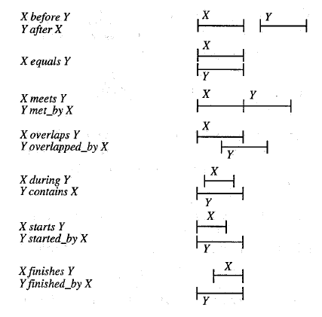
Comparison of Timestamps
Comparison of Timestamps is part of every temporal query language
Many query languages adopt (a variant of) Allen’s 13 period relations:

Slide 26
SQL + Abstract Data Types
Extend existing language (e.g. SQL) with time data types and associated predicates and functions
e.g. predicates for timestamp comparison
Earliest and (from a language design perspective) simplest approach
Has limited impact on existing language and is well understood technically
An abstract data type does not offer a systematic way to generalize snapshot queries to temporal queries
New and very complex solutions must be invented (i.e. programmed) to implement common temporal operations:
Temporal join, temporal aggregates, coalescence…
Enforcement of key constraints, sequenced semantics…

Slide 27
The IXSQL Approach [Lorentzos et al.]
IXSQL extends SQL-92 with (time) period data type
Periods are convenient for representing temporal aspects, but create difficulties when formulating temporal queries
IXSQL addresses this problem by normalizing timestamps so that they are aligned (identical or disjoint):
Function UNFOLD: decompose a period-timestamped tuple into a set of point-timestamped tuples (one for each point in the original period)
Function FOLD: collapse a set of point timestamped tuples into value-equivalent tuples timestamped with maximum periods
General pattern for query processing using fold/unfold:
Construct the point-based representation by unfolding the argument relation(s)
Compute the query on point-based representation
Fold the result to end up with an period-based representation

Slide 28
The IXSQL Approach
Example of a temporal join (sequenced semantics):
SELECT DeptName, Location, DeptManager, Salary, intervsect(Department.T, Employee.T) as T FROM Employee, Department WHERE EmpName = DeptManager AND Department.T overlaps Employee.T AND Location = 'Miami’ REFORMAT AS FOLD T
(the REFORMAT AS FOLD instruction, i.e. UNFOLD to time instants followed by FOLD to time periods, is necessary for coalescence of tuples in the result)

Slide 29
The IXSQL Approach
Only two functions, fold and unfold, are added to SQL
Unfold can be used when needed to formulate queries about each time point (it is optional and not an invasive change at query language level)
Efficient evaluation of queries formulated using fold/unfold has yet to be resolved
Neither a purely point-based nor period-based view:
Sensitive to specific period representation of data (e.g. queries that do not use fold/unfold)
Fold/unfold only preserve information of a point-based view
Normalization step using unfold/fold loses period information
Fold is not the inverse of unfold (information about the original periods is lost)
The combination of “at each time point” and periods is not supported (sequenced semantics with periods cannot be supported)

Slide 30

The TSQL2 Language (Temporal SQL-92 Extension)

Slide 31
The TSQL2 Language
Desired features of the underlying data model that inspired the TSQL2 design:
TSQL2 should not distinguish between value-equivalent instances (to provide conceptual simplicity)
TSQL2 should support only one valid-time dimension
TSQL2 should support transaction time
For simplicity, tuple timestamping should be employed
Event and state tables should be supported
Valid-time support should include support for both the past and the future
Timestamp values should not be limited in range or precision

Slide 32
The TSQL2 Language
Proper desired features of the query language that inspired the TSQL2 design:
TSQL2 should be a consistent, fully upward compatible extension of SQL-92
TSQL2 should allow the restructuring of tables on any set of attributes
TSQL2 should allow for flexible temporal projection
Operations in TSQL2 should not accord any explicit attributes special semantics (e.g. op. relying on keys)
Temporal support should be optional, on a per-table basis

Slide 33
The TSQL2 Language
Proper desired features of the query language that inspired the TSQL2 design:
User-defined time support should include instants, periods and intervals
Existing aggregates should have temporal analogues in TSQL2
Multiple calendars and multiple language support should be present in timestamp I/O and operations
It should be possible to derive temporal and non-temporal tables from underlying temporal and non-temporal tables

Slide 34
The TSQL2 Language
Ease of implementation was made a priority in the design:
TSQL2 tables should be implemented in terms of tables in some 1NF representational model
TSQL2 should have an efficiently implementable algebra that allows for optimization and that is an extension of the snapshot algebra
The TSQL2 data model should allow multiple representational data models

Slide 35
The TSQL2 Language
Timestamping columns are “hidden columns” with an implied special semantics and syntactic defaults have been embedded in order to make the formulation of common temporal queries easier
For example, intersection of the valid time of all the relations involved in a query to be assigned as timestamps to the results is automatically done, yielding:
Snapshot reducibility is ensured
Sequenced semantics is enforced by default
The implied sequenced semantics can be overridden via a custom temporal projection or explicit manipulation of timestamps for temporal selection

Slide 36
Time Representation in TSQL2
Time representation conforms to the BDCM
Time is discrete with chronons as base unit
Available base temporal datatypes:
Datetime (instant)
Period
Interval
Such datatypes are inherited from the SQL-92 specification but with several flaws fixed

Slide 37
The Datetime Datatype
Conforms to predefined SQL-92 types: DATE, TIME, TIMESTAMP (compliant to ISO 8601 standard formats)
Examples:
DATE '2016-02-29'
DATE 'February 29, 2016'
TIME '21:30:10'
TIME '9:30:10 PM'
TIMESTAMP '2015-12-31 12:00:00.00'
TIMESTAMP 'Noon December 31, 2015'

Slide 38
The Period Datatype
Represents open/closed time periods
Examples:
PERIOD '[March 2014]'
PERIOD '(2010]'
PERIOD '[1994-01-01 - 1994-01-31)'
PERIOD '(12:15:00.0 - 12:16:00.0)'
PERIOD '[Midnight July 1, 2013
- September 10, 2014 10:20 AM]'

Slide 39
The Interval Datatype
Represents unanchored pure durations
Examples:
INTERVAL '10' YEAR
INTERVAL 'November' DAY
INTERVAL '3' WEEK
INTERVAL '02:30' HOUR TO MINUTE
INTERVAL '-20' SECOND (cf. negative duration)

Slide 40
Mixed Expressions
A set of any datetime (period) data is an instant set (temporal element): in any case it is a set of chronons
Examples:
PERIOD '[2014-01-01 - 2014-06-01]'
+ INTERVAL '10' MONTH
= PERIOD '[2014-11-01 - 2015-04-01]‘
TIMESTAMP ‘2000-01-01 12:30'
+ INTERVAL 'February 2016' DAY
= TIMESTAMP ‘2000-01-30 12:30'

Slide 41
Mixed Expressions
Further examples:
PERIOD 'March 2014' + INTERVAL '10' DAY
= PERIOD '[2014-03-11 - 2014-04-10]‘
TIMESTAMP '13:30 April 1, 2000'
+ INTERVAL '1' YEAR - INTERVAL '15' MINUTE
= TIMESTAMP '2001-04-01 13:15'
Special predefined constants: BEGINNING, FOREVER, INITIATION, UNTIL_CHANGED, CURRENT_TIMESTAMP, NOW (possibly with nobind option)

Slide 42
Schema Declaration and Modification
Temporal definition clause AS… (6 temporal table types)
Examples:
CREATE TABLE Employee ( … ) AS VALID STATE
CREATE TABLE Department ( … ) AS VALID AND TRANSACTION
CREATE TABLE Transfer ( … ) AS VALID EVENT DAY
ALTER TABLE Employee ADD TRANSACTION

Slide 43
Temporal Selection
Selection based on temporal conditions in the WHERE clause
Temporal comparison operators (for datetime, period, instant set and element): PRECEDES, =, OVERLAPS, MEETS, CONTAINS
Comparison (<, =, >) and arithmetic (+, -, *) operators for intervals
Various functions: BEGIN(.), END(.), FIRST(.), LAST(.), INTERSECT(.,.), + , -
Constructors: PERIOD(.,.)
Timestamp extractors: VALID(.), TRANSACTION(.)

Slide 44
Temporal Comparison Operators
The semantics of TSQL2 temporal comparison operators corresponds to their meaning in natural language (whereas Allen’s operators have artificial and innatural names), following the SQL (SEQUEL) philosophy
X PRECEDES Y iff END(X) < BEGIN(Y)
X = Y iff X and Y are identical
X OVERLAPS Y iff X ∩ Y ≠ ∅
X MEETS Y iff X PRECEDES Y without any instants in between
X CONTAINS Y iff X ⊇ Y

Slide 45
Temporal Comparison Operators
The TSQL2 temporal comparison operators can be used with instants, periods and elements, and also for mixed comparisons (e.g. elements with instants)
As to periods, TSQL2 is anyway Allen-complete
X = Y has been preferred to X EQUALS Y not to introduce a new keyword
For the same reason, inverse operators have not been considered necessary
X MET_BY Y can be expressed as Y MEETS X
X FOLLOWS Y can be expressed as Y PRECEDES X
X DURING Y can be expressed as Y CONTAINS X

Slide 46
Temporal Selection - Examples
SELECT * FROM Employee WHERE EmpName = 'Ted'
SELECT Salary FROM Employee WHERE VALID(Employee) CONTAINS DATE 'NOW'
SELECT * FROM Employee WHERE EmpName = 'Ted' AND VALID(Employee) OVERLAPS PERIOD '[2013]' + PERIOD '[2015]'

Slide 47
Temporal Selection - Examples
SELECT EmpName, Salary FROM Employee WHERE FIRST(VALID(Employee)) CONTAINS PERIOD '[1990-06-15 - 1990-07-15]'
SELECT EmpName, Salary FROM Employee WHERE Job = 'Programmer' AND LAST(VALID(Employee)) PRECEDES DATE '2014-03-01'

Slide 48
Temporal Projection
Assignment of a timestamp to the results of a query done with the VALID (VALID INTERSECT) clause
Examples:
SELECT SNAPSHOT EmpName, DateOfBirth FROM Employee WHERE Job='Engineer'
SELECT DISTINCT EmpName FROM Employee VALID PERIOD(DateOfBirth, DATE 'FOREVER') WHERE Job = 'Manager'

Slide 49
Temporal Projection - Examples
SELECT Department.*, Employee.Salary FROM Employee, Department VALID INTERSECT (Employee, Department) WHERE EmpName = DeptManager AND VALID(Employee) OVERLAPS VALID(Department) AND Location = 'Miami'
SELECT Department.*, Employee.Salary FROM Employee, Department WHERE EmpName = DeptManager AND Location = 'Miami'
(the same VALID clause as above is understood and, thus, the overlap is implied; cf. temporal join)

Slide 50
TSQL2 Range Variables
The TSQL2 range variables generalize the concept of history variables [Grandi] and allow for temporal restructuring [Gadia] of a relation. Automatic coalescing of timestamps is implied
In the FROM clause: FROM Employee(EmpName) AS Emp the variable Emp ranges over groups of tuples of the relations with the same EmpName attribute value. Grouping can also be based on periods
Notice that the clause FROM Employee is equivalent to FROM Employee AS Employee that is to FROM Employee(*) AS Employee

Slide 51
TSQL2 Range Variables
Declaration of range variables (and, thus, grouping) can be nested:
FROM Employee(EmpName) AS Emp, Emp(Job) AS E1, E2
is equivalent to:
FROM Employee(EmpName) AS Emp, Employee(EmpName,Job) AS E1, E2 WHERE E1.EmpName=Emp.EmpName AND E2.EmpName=Emp.EmpName
(groups are synchronized on the common attributes; nested declarations are “syntactic sugar”)

Slide 52
TSQL2 Range Variables
Examples:
SELECT * FROM Employee(EmpName,Salary) AS Emp WHERE Salary = 2500 AND CAST(Emp AS INTERVAL YEAR) >= INTERVAL '2' YEAR
SELECT SNAPSHOT E1.EmpName, BEGIN(VALID(E2)) FROM Employee(EmpName) AS Emp, Emp(Job,Salary) AS E1, E2 WHERE E1 MEETS E2 AND E1.Job <> E2.Job AND E1.Salary = E2.Salary

Slide 53
TSQL2 Range Variables
Examples:
SELECT E1.EmpName, E1.Job FROM Employee(EmpName) AS Emp, Emp(Job)(PERIOD) AS E1, E2, E3 WHERE E1 MEETS E2 AND E2 MEETS E3 AND E1.Job <> E2.Job AND E1.Job = E3.Job AND E2.Job = 'Manager'
SELECT Emp.* FROM Employee(EmpName) AS Emp, Emp(Job) AS E1, Emp(Salary) AS E2 WHERE E1.Salary = 2300 AND E2.Job = 'DeptHead' AND BEGIN(VALID(E2)) - END(VALID(E1)) > INTERVAL '18' MONTH

Slide 54
TSQL2 Modification Operations
The VALID clause allows for the specification of the applicability period of the modification
Examples:
INSERT INTO Employee VALUES ('Kim', '1982-05-15', 'Engineer', 2500) VALID PERIOD( DATE '2016-01-01', NOBIND(DATE 'NOW') )
Employee
EmpName | DateOfBirth | Job | Salary | VALID
Kim | 15/5/1982 | Engineer | 2500 | [1/1/2016, Now)

Slide 55
TSQL2 Modification Operations
Examples:
UPDATE Employee SET Salary = Salary + 200 WHERE EmpName = 'Kim' AND VALID(Employee) CONTAINS DATE 'CURRENT_TIMESTAMP' VALID PERIOD 'February 2016'
Employee
EmpName | DateOfBirth | Job | Salary | VALID
Kim | 15/5/1982 | Engineer | 2500 | [1/1/2016, 1/2/2016)
Kim | 15/5/1982 | Engineer | 2700 | [1/2/2016, 1/3/2016)
Kim | 15/5/1982 | Engineer | 2500 | [1/3/2016, Now)

Slide 56
TSQL2 Modification Operations
Examples:
DELETE FROM Employee WHERE EmpName = 'Kim' VALID PERIOD '[2016-06-01 - FOREVER]'
Employee
EmpName | DateOfBirth | Job | Salary | VALID
Kim | 15/5/1982 | Engineer | 2500 | [1/1/2016, 1/2/2016)
Kim | 15/5/1982 | Engineer | 2700 | [1/2/2016, 1/3/2016)
Kim | 15/5/1982 | Engineer | 2500 | [1/3/2016, 1/6/2016)

Slide 57
TSQL2 Modifications and Surrogates
Surrogates are transparent time-invariant identifiers
Example:
CREATE TABLE Supplier(ID SURROGATE, Name CHAR PRIMARY KEY, Address CHAR) AS VALID;
INSERT INTO Supplier VALUES (NEW, 'Acme Inc.', 'New York') VALID PERIOD '[2014-01-01 - FOREVER]' Supplier
ID | Name | Address | VALID
[S1] | Acme Inc. | New York | [1/1/2014, Forever)

Slide 58
TSQL2 Modifications and Surrogates
INSERT INTO Supplier SELECT ID, 'New Acme Ltd.', Address FROM Supplier WHERE Name = 'Acme Inc.' VALID PERIOD '[2016-01-01 - FOREVER]'
or: UPDATE Supplier SET Name = 'New Acme Ltd.' WHERE ID = ( SELECT ID FROM Supplier WHERE Name = 'Acme Inc.' ) VALID PERIOD '[2016-01-01 - FOREVER]'
Supplier
ID | Name | Address | VALID
[S1] | Acme Inc. | New York | [1/1/2014, 1/2/2016)
[S1] | New Acme Ltd. | New York | [1/1/2016, Forever)

Slide 59
TSQL2 Aggregate Functions
Temporal grouping criteria:
Partition domain (valid or user-defined, instant or period)
Partition granularity
Associated time window (LEADING and TRAILING options)
Group belonging
Example:
SELECT Salary FROM Employee AS Emp1 WHERE Emp1.EmpName = 'Tony' AND VALID(Emp1) OVERLAPS ( SELECT MIN(VALID(Emp2)) FROM Emp AS Emp2 WHERE Emp2.EmpName = 'Eve' )

Slide 60
TSQL2 Aggregate Functions
Examples:
SELECT EmpName, SUM(WEIGHTED Salary) FROM Employee(EmpName) AS Emp GROUP BY VALID(Emp) USING '1' YEAR HAVING MIN(Salary) > 2500
SELECT AVG(WEIGHTED Salary) FROM Employee WHERE EmpName = 'Tony' GROUP BY VALID(Employee) USING '1' MONTH LEADING '11' MONTH

Slide 61
Calendars and Calendric Systems
Calendars and calendric systems composed of multiple calendars are supported in TSQL2
Ex. of calendars: Gregorian, Julian, Astronomic, Traditional_Chinese, US_Fiscal, UniBO_Academic
Ex. of a calendric system: Russian (Roman till100 B.C. then Julian till1917, then Gregorian till1929, then Communist till1931 and then Gregorian again)
Selection of a calendric system (Gregorian) in TSQL2:
DECLARE CALENDRIC SYSTEM AS SQL92_CALENDRIC_SYSTEM

Slide 62
Calendars and Calendric Systems
Calendars are necessary for correct I/O and formatting of time data, that can be specified via the DATETIME_FORMAT property, ex.
SET PROPERTY FOR Italian_Calendar WITH VALUES ( ' DATETIME_FORMAT ', ' <DAY>/<MONTH>/<YEAR> <HOUR>:<MINUTE>:<SECOND> ' )
then '19/02/2016 ' is a correct date literal for the Italian_Calendar
Time zones and daylight saving are also supported, e.g. the following expressions are equivalent:
TIME '10:30:25' AT TIME ZONE INTERVAL '1' HOUR
TIME '10:30:25' AT TIME ZONE 'CET'
TIME '10:30:25+01:00'

Slide 63
Calendars and Calendric Systems
Like in SQL-92, an EXTRACT() operator is also available to extract components from a temporal expression.
Examples:
EXTRACT (HOUR FROM TIME '01:27.30 PM')
returns 13
EXTRACT (MONTH FROM DATE 'June 7, 2010')
returns 6
EXTRACT (TIMEZONE_HOUR FROM TIMESTAMP '2015-05-13 13:27.30-4:00')
returns -4

Slide 64

Temporal Indeterminacy
Based on a probabilistic approach [Dyreson & Snodgrass]
An indeterminate instant t = (t⁻ ~ t⁺, P) is represented through:
Its lower (t⁻) and upper (t⁺) support
Its probability distribution P (null outside the support)
Evaluation of selection predicates involving indeterminate instants (at a given plausibility level p) is based on the Before() primitive:
where the precedence probability is evaluated as:

Slide 65
Temporal Indeterminacy
The probability distribution can be STANDARD (i.e. UNIFORM or MISSING) or NONSTANDARD
Non standard distributions are user-defined point by point such that:
P(i) = 0 if i<t⁻ or i>t⁺
Σt⁻≤i≤t⁺ P(i)=1
Non standard distributions samples with predefined shapes could be provided by the system or made available by a DBA (e.g. PROBABLY_EARLY, PROBABLY_VERY_LATE, AROUND etc.)

Slide 66
Temporal Indeterminacy
Example:
CREATE TABLE
Shipment( ParcelNo CHAR PRIMARY KEY, Destination CHAR,
Arrival NONSTANDARD INDETERMINATE DATE )
INSERT INTO Shipment
VALUES ('P102', 'Rome', '2016-02-20 ~ 2016-02-24'
WITH DISTRIBUTION PROBABLY_EARLY)
SELECT * FROM Shipment
WHERE Destination='Paris'
AND VALID(Shipment) OVERLAPS
DATE '2016-03-01' WITH PLAUSIBILITY '95'

Slide 67
Granularities in TSQL2
Granularities are based on the lattice associated to a calendar
TSQL2 extends the mechanism available in SQL-92 for the INTERVAL datatype, e.g. INTERVAL DAY TO SECOND (duration at a granularity between day and second)
The upper granularity may be expressed as a range, e.g. INTERVAL '1000' DAY TO SECOND
TSQL2 allows granularity definitions also for instant and period datatypes
A precision specification can also be used, e.g. TIME MINUTE(2) TO SECOND(3)
The first is a range spec. (10² minutes) the second spec. is the maximum number of decimal digits (10⁻³ seconds)

Slide 68
Granularities in TSQL2
Comparison on operands with different granularities are effected at the granularity of the left operand
Explicit granularity conversions are possible by means of the SCALE and CAST operators, e.g.
SCALE(DATE '2010-01-01' AS MONTH) CAST(DATE '2010-01-01' AS MONTH) both return 'January 2010'
SCALE(DATE '2010-01-01' AS MINUTE) returns '2010-01-01 00:00 ~ 2010-01-01 23:59' (indeterm.)
CAST(DATE '2010-01-01' AS MINUTE) returns '2010-01-01 00:00' (the first value at the finer gran.)
SCALE(DATE 'March 2014 ~ April 2014' AS DAY) returns '2014-03-01 ~ 2014-04-30' (maximizes indet.)
CAST(DATE 'March 2014 ~ April 2014' AS DAY) returns '2014-03-01 ~ 2014-04-01' (converts the supports)

Slide 69
The ATSQL Approach
ATSQL [Böhlen, Jensen & Snodgrass] uses temporal statement modifiers to add temporal support to SQL
Statement modifiers are semantic defaults that indicate “at each time point” without specifying how to compute it
Provides a systematic way to construct temporal queries from non-temporal queries:
1. Formulate the corresponding non-temporal query
2. Apply a statement modifier
Example: Temporal join
Formulate the non-temporal join
Modifier ensures that the argument timestamps overlap and that the result timestamp is the intersection of the argument periods
ATSQL assumes period-timestamped tuples:
Periods have a meaning beyond a set of points

Slide 70
The ATSQL Approach
Example (temporal join):
SEQ VT SELECT Department.*, Employee.Salary FROM Employee, Department WHERE EmpName = DeptManager AND Location = 'Miami'
The NSEQ VT (“nonsequenced valid time”) modifier indicates that what follows should be treated as regular SQL, for example (tuple count):
NSEQ VT SELECT COUNT(*) FROM Employee

Slide 71
The ATSQL Approach
A query without a modifier considers only the present state of the argument relations (i.e. valid at NOW)
Ensures that legacy queries on non-temporal relations are unaffected if the non-temporal relations are made temporal, e.g.
SELECT * FROM Employee
The modifiers mechanism is independent of the syntactic complexity of the queries
The temporal parts are to a large degree separated from the non-temporal parts of the query
The semantics of SQL extended with statement modifiers has been defined

Slide 72
TDB Support in SQL:2011
The SQL/Temporal chapter was cancelled from the SQL3 definition in 2001 due to controversy within the ISO SQL committee (cf. ATSQL vs IXSQL approach)
New temporal language extensions were recently submitted to and accepted by the ISO SQL committee as part of the SQL/Foundation Chapter of the new SQL:2011 standard
The ability to create and manipulate temporal tables is the most important new feature in SQL:2011

Slide 73
TDB Support in SQL:2011
Valid-time tables, dubbed as “Application-time period tables”, are supported
Transaction-time tables, dubbed as “System-versioned tables”, are supported
Bitemporal tables, dubbed as “System-versioned application-time period tables” (!), are supported
Period timestamping is supported via 2 columns
Temporal primary key and referential integrity constraints are supported
Predicates are defined for querying along valid and transaction time

Slide 74
Application-time Period Tables
Application-time period tables are tables that contain a PERIOD clause (newly-introduced) with a user-defined period name
Application-time period tables must contain two (user-defined) additional columns to store the start and end time of a period associated with the row
Values of both start and end columns are set by the users
Additional syntax is provided for users to specify primary key/unique constraints that ensure no two rows with the same key value have overlapping periods

Slide 75
Creating an Application-time Period Table
CREATE TABLE Employee
(emp_name VARCHAR(50) NOT NULL PRIMARY KEY,
dept_id VARCHAR(10),
start_date DATE NOT NULL, end_date DATE NOT NULL,
PERIOD FOR emp_period (start_date, end_date),
PRIMARY KEY (emp_name, emp_period WITHOUT OVERLAPS),
FOREIGN KEY (dept_id, PERIOD emp_period) REFERENCES
Department (dept_id, PERIOD dept_period))
PERIOD clause automatically enforces the constraint end_date > start_date
The name of the period can be any user-defined name
The timestamping period is considered open to the right, i.e. [start_date, end_date)

Slide 76
Querying an Application-time Period Table
Application-time period tables can be queried using the regular SQL syntax (temporal selection predicates can be expressed using comparison conditions over the timestamping columns)
More user-friendly and Allen-complete period comparators (reminiscent of the TSQL2 ones) are also available:
CONTAINS, OVERLAPS, EQUALS, PRECEDES, SUCCEEDS, IMMEDIATELY PRECEDES, IMMDIATELY SUCCEEDS
Ex. SELECT * FROM Employee WHERE emp_period CONTAINS PERIOD '2015'
SELECT DISTINCT E1.emp_name, E2.emp_name FROM Employee E1, E2 WHERE E1.emp_name < E2.emp_name AND E1.dept_id = E2.dept_id AND E1.emp_period OVERLAPS E2.emp_period

Slide 77
Modifying an Application-time Period Table
Regular INSERT, UPDATE, DELETE statements can be used by explicitly managing values of conventional columns but also of the timestamping columns
A more user-friendly new FOR PORTION clause can be used to specify the applicability period of modifications
Ex. UPDATE Employee FOR PORTION OF emp_period FROM DATE '2015-05-01' TO DATE '2015-06-01' SET dept_id = 'D5' WHERE emp_name = 'Tom'
DELETE Employee FOR PORTION OF emp_period FROM DATE '2016-03-01' TO DATE '9999-12-31' WHERE emp_name = 'Annabel'

Slide 78
System-versioned Tables
System-versioned tables are tables that contain a PERIOD clause with a pre-defined period name (SYSTEM_TIME) and specify WITH SYSTEM VERSIONING
System-versioned tables must contain two additional (user-defined) columns to store the start and end time of the SYSTEM_TIME period
Values of both start and end columns are set by the system (users are not allowed to supply values)

Slide 79
System-versioned Tables
Unlike regular tables, system-versioned tables preserve the old versions of rows as the table is updated
Rows whose periods intersect the current time are called current system rows. All others are called historical system rows
Only current system rows can be updated or deleted. System time applicability of modifications cannot be managed by the user
All constraints are enforced on current system rows only

Slide 80
Creating a System-versioned Table
CREATE TABLE Employee
(emp_name VARCHAR(50) NOT NULL, dept_id VARCHAR(10),
system_start TIMESTAMP(6) GENERATED ALWAYS AS ROW START,
system_end TIMESTAMP(6) GENERATED ALWAYS AS ROW END,
PERIOD FOR SYSTEM_TIME (system_start, system_end),
PRIMARY KEY (emp_name),
FOREIGN KEY (dept_id) REFERENCES Department (dept_id);
) WITH SYSTEM VERSIONING
Unlike regular tables, system-versioned tables preserve the old versions of rows as the table is updated
PERIOD clause automatically enforces the constraint system_end > system_start
The name of the period must be SYSTEM_TIME
The timestamping period is considered open to the right

Slide 81
Querying a System-versioned Table
The clause FOR SYSTEM_TIME can be used after the FROM clause to access past states of a table along transaction time (rollback queries)
It comes with three variants:
FOR SYSTEM_TIME AS OF T (current at T)
FOR SYSTEM_TIME FROM T1 TO T2 (current in [T1,T2) )
FOR SYSTEM_TIME BETWEEN T1 AND T2 (current in [T1,T2] )
Ex. SELECT * FROM Employee FOR SYSTEM_TIME FROM TIME '2011-01-01' TO TIME '2011-12-31‘
SELECT * FROM Employee FOR SYSTEM_TIME AS OF TIMESTAMP '2014-04-01 12:30:00'

Slide 82
Creating a System-versioned Application-time Table
CREATE TABLE Employee
(emp_name VARCHAR(50) NOT NULL PRIMARY KEY,
dept_id VARCHAR(10),
start_date DATE NOT NULL, end_date DATE NOT NULL,
system_start TIMESTAMP(6) GENERATED ALWAYS AS ROW START,
system_end TIMESTAMP(6) GENERATED ALWAYS AS ROW END,
PERIOD FOR emp_period (start_date, end_date),
PERIOD FOR SYSTEM_TIME (system_start, system_end),
PRIMARY KEY (emp_name, emp_period WITHOUT OVERLAPS),
FOREIGN KEY (dept_id, PERIOD emp_period) REFERENCES
Department (dept_id, PERIOD dept_period)
) WITH SYSTEM VERSIONING

Slide 83
Cf. Creating the same Table in TSQL2…
CREATE TABLE Employee
(emp_name VARCHAR(50) NOT NULL PRIMARY KEY,
dept_id VARCHAR(10),
FOREIGN KEY dept_id REFERENCES Department
) AS VALID AND TRANSACTION
In practice, it is the same declaration done with regular SQL of a snapshot table Employee, simply augmented with the “AS VALID AND TRANSACTION” bitemporal specification (that implies the so deprecated syntactic and semantic defaults)

