Slide 1
A Relational Algebra for Streaming Tables Living in a Temporal Database World
24th International Symposium on Temporal Representation and Reasoning (TIME 2017)
Fabio Grandi¹, Federica Mandreoli², Riccardo Martoglia², Wilma Penzo¹
¹University of Bologna, Italy ²University of Modena and Reggio Emilia, Italy
Notes:
1

Slide 2
Motivation
Modern data-intensive applications more and more widespread
E.g. advanced surveillance, monitoring, military, network app
Increasingly wider range of data management capabilities required
Very large quantities of continuously streaming data
Historical data fully available for analysis
Complex continuous queries (CQs) on both recent and historical data
Complex one-time queries (OTQs) and temporal analytics on (temporal) relational data
Uniform and expressive querying exploiting standard RDBMS’s languages and algebras
TIME 2017 - F. Grandi, F. Mandreoli, R. Martoglia, W. Penzo - A Relational Algebra for Streaming Tables Living in a Temporal Database World
2
Notes:
2

Slide 3
Motivation
State-of-the-art data management systems still trying to fully address them
Streaming extensions to traditional DBMSs
Big data processing engines
Stream processing frameworks
A first step: the Streaming table [CMM+17]
a fully native representation of streaming data in a DBMS
persistent structure managing both historical and streaming data
can be involved in OTQs and CQs together with standard relational tables
Relational data
management
Stream data
management
[CMM+17] L. Carafoli, F. Mandreoli, R. Martoglia, and W. Penzo. Streaming tables: Native support to streaming data in DBMSs. IEEE Trans. on Systems, Man, and Cybernetics: Systems, 47(10), pages 2768-2782, 2017.
TIME 2017 - F. Grandi, F. Mandreoli, R. Martoglia, W. Penzo - A Relational Algebra for Streaming Tables Living in a Temporal Database World
3
Notes:
3

Slide 4
Streaming tables
OPTION_TRADES
OPTION | STOCK | CLASS | STRIKE | EXPIR | CONTRACTS | T
Opt127 | Google | Call | 1100 | Dec 2017 | 200 | 1
OPTION | STOCK | CLASS | STRIKE | EXPIR | CONTRACTS | T
Opt245 | Tesla | Put | 300 | Jan 2018 | 350 | 2
Opt127 | Google | Call | 1100 | Dec 2017 | 200 | 1
OPTION | STOCK | CLASS | STRIKE | EXPIR | CONTRACTS | T
Opt666 | Apple | Put | 120 | Nov 2017 | 1280 | 3
Opt127 | Google | Call | 1100 | Dec 2017 | 150 | 3
Opt245 | Tesla | Put | 300 | Jan 2018 | 350 | 2
Opt127 | Google | Call | 1100 | Dec 2017 | 200 | 1
OPTION | STOCK | CLASS | STRIKE | EXPIR | CONTRACTS | T
Opt245 | Tesla | Put | 300 | Jan 2018 | 480 | 4
Opt666 | Apple | Put | 120 | Nov 2017 | 1280 | 3
Opt127 | Google | Call | 1100 | Dec 2017 | 150 | 3
Opt245 | Tesla | Put | 300 | Jan 2018 | 350 | 2
Opt127 | Google | Call | 1100 | Dec 2017 | 200 | 1
DATA STREAM a potentially infinite stream of timestamped relational tuples having a fixed schema
STREAMING TABLE a relational table where streaming data enter and turn historical by remaining stored for a user-defined long period, ideally forever
HISTORICAL PERIOD the life time span of stored data
An EVENT TIME TABLE in TDB terminology
Subject to continuous writes in timestamp order
TIME 2017 - F. Grandi, F. Mandreoli, R. Martoglia, W. Penzo - A Relational Algebra for Streaming Tables Living in a Temporal Database World
4
Notes:
4

Slide 5
Research objective
We now aim at breaking the barrier between
Streaming data management and
Temporal data management
We aim to integrate streaming tables in a temporal context
Relational data
management
Stream data
management
Temporal data
management
Temporal RDBMSs’ querying
Data versioning
On relational and streaming data
TIME 2017 - F. Grandi, F. Mandreoli, R. Martoglia, W. Penzo - A Relational Algebra for Streaming Tables Living in a Temporal Database World
5
Notes:
5

Slide 6
Continuous temporal algebra (CTA)
Start from temporal algebra TA
Extend it with windowing operators
Work on three kinds of tables: standard, temporal and streaming
CQs and OTQs are specified as algebraic expressions
OTQs are TA expressions → traditional TA semantics
CQs are CTA expressions → semantics relying on a sampling operator
The sampling operator evaluates expressions at required time points
”On-demand” semantics
Unified framework combining several CQ features in a consistent and well-founded setting
TIME 2017 - F. Grandi, F. Mandreoli, R. Martoglia, W. Penzo - A Relational Algebra for Streaming Tables Living in a Temporal Database World
6
Notes:
6

Slide 7
Translation rules
We then propose a correct translation of the continuous temporal model presented so far into the temporal model
CQs are transformed into standard temporal queries
This makes it possible to instantiate the framework in the context of a standard temporal RDBMS (i.e. an industrial-strength RDBMS whose kernel has been extended for temporal support)
TIME 2017 - F. Grandi, F. Mandreoli, R. Martoglia, W. Penzo - A Relational Algebra for Streaming Tables Living in a Temporal Database World
7
Notes:
7

Slide 8
Application example: insider trading tracking
A posteriori insider tracking detection key for pursuing prosecution of illegal activities
Aim: identify anomalous trading volume of an option, preceding by at most one week the public release of some news concerning the underlying stock
daily trading volume > 10x average daily volume over the past month
Option trading data in the streaming table
OPTION_TRADES(OPTION,STOCK,CLASS,STRIKE,EXPIR,CONTRACTS|T)
Relevant news selected and stored in the temporal table
NEWS(STOCK,TYPE,SOURCE|T)
OPTION_TRADES
?
NEWS
CQ: join on time that cannot be computed until the news are available
Time windows need to be evaluated in delayed mode!
TIME 2017 - F. Grandi, F. Mandreoli, R. Martoglia, W. Penzo - A Relational Algebra for Streaming Tables Living in a Temporal Database World
8
Notes:
8

Slide 9
Preliminaries
Discrete, ordered and unbounded time domain T composed of chronons
T : Semantics of valid time
Time spans belong to domain I
Temporal table R ∈R: R(A₁, … , A_{n}| T ) (R^{t}: content of R at time t)
Non-temporal tables: virtually converted to temporal tables R′ = {(r, τ ) | r ∈ R, τ ∈ T }
Streaming table S∈S with schema S(A₁, … , A_{n}) and hist. period hp ∈I: event table with schema S(A₁, … , A_{n}| T ), S^{t} : set of tuples s such that T(s) ≥ max(t − hp, 0)
TIME 2017 - F. Grandi, F. Mandreoli, R. Martoglia, W. Penzo - A Relational Algebra for Streaming Tables Living in a Temporal Database World
9
Notes:
9

Slide 10
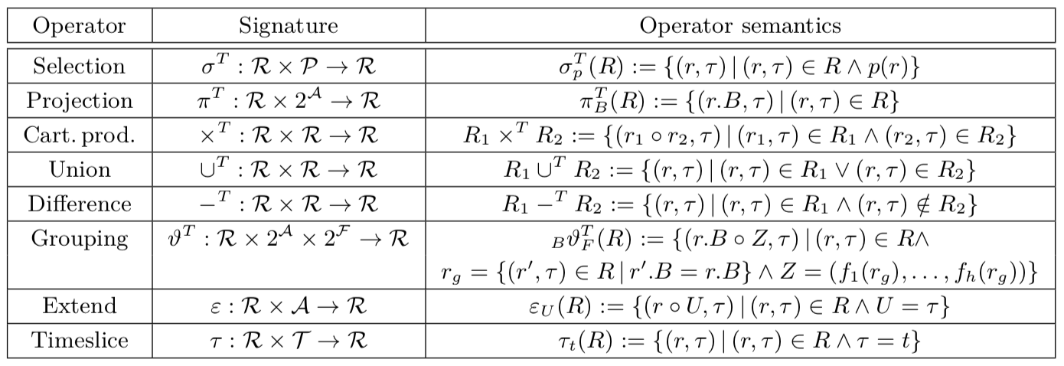
OTQs & temporal algebra TA
Temporal operators: generalization of standard relational operators
Selection 𝜎^{T}, projection 𝜋^{T}, Cartesian product x^{T}, union U^{T}, difference −^{T}, grouping 𝜗^{T}
Additional operators
Extend operator 𝜀_{U}
Extended timeslice operator 𝜏_{t}
Q = E_{TA} (S₁,...,S_{n},R₁,...,R_{m})
OTQ Semantics: result of the semantics of the involved temporal operators for which snapshot reducibility holds
TIME 2017 - F. Grandi, F. Mandreoli, R. Martoglia, W. Penzo - A Relational Algebra for Streaming Tables Living in a Temporal Database World
10
Notes:
10

Slide 11
CQs & continuous temporal algebra CTA
CQ Q^{c}: a query issued once and running continuously until terminated
Any streaming table S must be accessed through a windowing expression
A CTA algebra expression defining a CQ has the general form
E_{CTA} = E_{TA} (𝛼₁(⍵₁(S₁)),…, 𝛼_{n}(⍵_{n}(S_{n})),R₁,... ,R_{m})
Streaming tables may appear in windowing espressions 𝛼(⍵(S)), where ⍵ is a (partitioned) sliding window operator and 𝛼 is a (partitioned) window flattening/aggregation operator
TIME 2017 - F. Grandi, F. Mandreoli, R. Martoglia, W. Penzo - A Relational Algebra for Streaming Tables Living in a Temporal Database World
11
Notes:
11

Slide 12



CQs & continuous temporal algebra CTA
CTA extends usual set of windowing operators to sequences of windows
Streaming tables of streaming tables and sets of streaming tables of streaming tables are formally involved in the definition of CTA operators
Utility operators
Substreaming
Streaming table partition
TIME 2017 - F. Grandi, F. Mandreoli, R. Martoglia, W. Penzo - A Relational Algebra for Streaming Tables Living in a Temporal Database World
12
Notes:
12

Slide 13






CTA: sliding windows operators
Time-based and count-based, generate streaming table of streaming tables
Time-based sliding window
Count-based sliding window
Time-based partitioned window
Count-based partitioned window
TIME 2017 - F. Grandi, F. Mandreoli, R. Martoglia, W. Penzo - A Relational Algebra for Streaming Tables Living in a Temporal Database World
13
Notes:
13

Slide 14



CTA: window flattening operators
Normalize (sets of) streaming tables of streaming tables to flat streaming tables
Window flattening
Partitioned window flattening
TIME 2017 - F. Grandi, F. Mandreoli, R. Martoglia, W. Penzo - A Relational Algebra for Streaming Tables Living in a Temporal Database World
14
Notes:
14

Slide 15


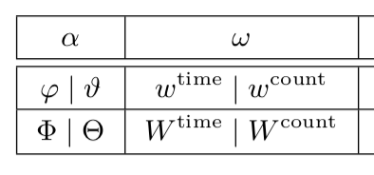
CTA: window aggregation operators
Compute aggregate data over time-based or count-based sliding windows according to a set of aggregation functions F
Window aggregation
Partitioned window aggregation
Note: a windowing expression applied to S has the form
𝛼 (⍵(S))
Window aggregation/flattening op.
Sliding window op.
TIME 2017 - F. Grandi, F. Mandreoli, R. Martoglia, W. Penzo - A Relational Algebra for Streaming Tables Living in a Temporal Database World
15
Notes:
15

Slide 16



Example of CTA expression:
S(A|T) | T
 | 3
 | 2
 | 1
A | T
5 | 3
20 | 2
A | U | T
5 | 3 | 3
20 | 2 | 3
20 | 2 | 2
10 | 1 | 2
10 | 1 | 1
A | T
5 | 3
20 | 2
10 | 1
A | T
20 | 2
10 | 1
(streaming table)
A | T
10 | 1
(streaming table)
[streaming table of streaming tables]

Slide 17


Example of CTA expression:
S(A|T) | T
 | 3
 | 2
 | 1
A | T
5 | 3
20 | 2
A | T
5 | 3
20 | 2
10 | 1
SUM(A) | T
25 | 3
30 | 2
10 | 1
A | T
20 | 2
10 | 1
(streaming table)
A | T
10 | 1
(streaming table)
[streaming table of streaming tables]

Slide 18
CQs: definition of the sampling points
sliding parameter
0 sl 2sl 3sl 4sl 5sl 6sl 7sl
t-hp
t
a sl+a 2sl+a 3sl+a 4sl+a 5sl+a 6sl+a 7sl+a
t₀ t₁ t₂ t₃
alignment
sampling points
historical period
execution time
TIME 2017 - F. Grandi, F. Mandreoli, R. Martoglia, W. Penzo - A Relational Algebra for Streaming Tables Living in a Temporal Database World
18
Notes:
18

Slide 19

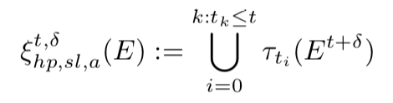

CQs: sampling operator and semantics
Sampling operator: executes E ∈ CTA at time points t_{i} ≤ t
Execution time t
Historical period hp
Sliding parameter sl
Alignment parameter a
(Optional) delay parameter 𝛿
Q_{hp,sl,a} = ξ _{hp,sl,a} (E_{CTA} ) = ξ _{hp,sl,a} (E_{TA} (𝛼₁(⍵₁(S₁)),…, 𝛼_{n}(⍵_{n}(S_{n})),R₁,... ,R_{m}))
CQ Semantics: the result at time t is the streaming table given by the sampling ξ at the time points specified by sl with alignment a, and evaluation delayed by 𝛿, until t
”On-demand” semantics + different kinds of joining semantics
^{c,𝛿}
^{c,𝛿}
^{c,𝛿}
TIME 2017 - F. Grandi, F. Mandreoli, R. Martoglia, W. Penzo - A Relational Algebra for Streaming Tables Living in a Temporal Database World
19
Notes:
19

Slide 20
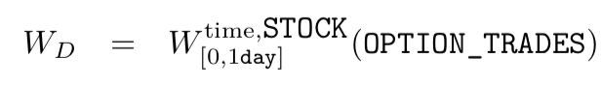



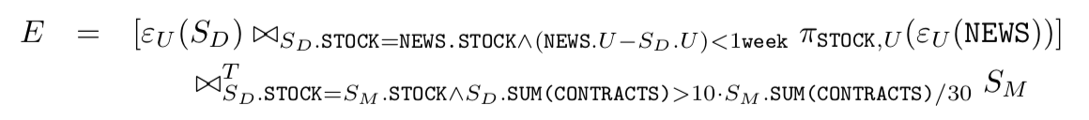

Application example reprise
Daily trading volume > 10x average daily volume over the past month
1-day wide sliding window following evaluation time, partitioned
1-month wide sliding window preceding evaluation time, partitioned
OT
OT
total number of contracts executed in W_{D} for each evaluation time
total number of contracts executed in W_{M} for each evaluation time
N
join with news on the same stock published within 1 week from the evaluation time
temporal join to test the anomalous volume condition
continuous evaluation delayed by 15 days at the specified sampling points
TIME 2017 - F. Grandi, F. Mandreoli, R. Martoglia, W. Penzo - A Relational Algebra for Streaming Tables Living in a Temporal Database World
20
Notes:
20

Slide 21
Translating CQs into OTQs
New temporal model where OTQs are transformed into temporal OTQs
Concrete temporal model (interval-based), extended sequenced semantics
Point-based query language
A | T
10 | 2
25 | 1
A | T | Tꞌ
10 | 2 | [2,∞)
25 | 1 | [1,∞)
S^{CTA} S^{TA}
S(X|T ) S(X,T |T’ )
Explicit event occurrence time
Implicit interval tuple validity
B | T
10 | 3
5 | 2
5 | 1
R^{CTA} R^{TA}
B | Tꞌ
10 | [3,3)
5 | [1,2)
R(X|T ) R(X |T’ )
Intervals obtained by coalescing timepoints
TIME 2017 - F. Grandi, F. Mandreoli, R. Martoglia, W. Penzo - A Relational Algebra for Streaming Tables Living in a Temporal Database World
21
Notes:
21

Slide 22
Translating CQs into OTQs
Semantics of the continuous operators is defined through TA operators
CTA expressions are evaluated through a sampling operator ξ ^{TA}
defined at the TA level, which produces a pure TA expression
tset is the evaluation time instant set implied by the sampling operator
Sliding window expressions do not need to be evaluated for time points non belonging to tset
TIME 2017 - F. Grandi, F. Mandreoli, R. Martoglia, W. Penzo - A Relational Algebra for Streaming Tables Living in a Temporal Database World
22
Notes:
22

Slide 23
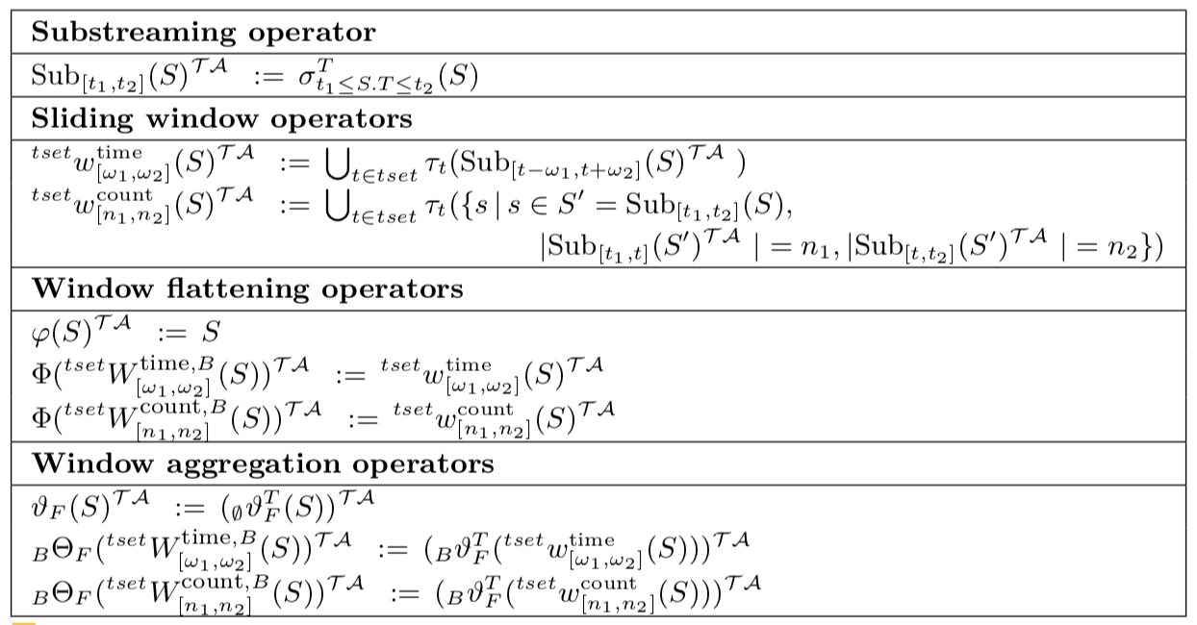
Translating CQs into OTQs
Definition of the semantics of the continuous operators in TA
TIME 2017 - F. Grandi, F. Mandreoli, R. Martoglia, W. Penzo - A Relational Algebra for Streaming Tables Living in a Temporal Database World
23
Notes:
23

Slide 24

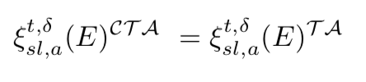
Translating CQs into OTQs
Sampling operator ^{TA}
In the paper, we prove that
We can translate each CQ in CTA into an equivalent expression in TA (and have them executed by a “traditional” temporal relational engine!)
TIME 2017 - F. Grandi, F. Mandreoli, R. Martoglia, W. Penzo - A Relational Algebra for Streaming Tables Living in a Temporal Database World
24
Notes:
24

Slide 25
Conclusions
We presented a temporal algebra extended with windowing and flattening/aggregation operators supporting both OTQs and CQs on streaming, standard and temporal relational data.
Our approach…
…overcomes the transformation overhead of stream-relation-stream approaches
We proved that it is possible to exploit the full potential of a native representation of temporal data to query streaming data seamlessly
TIME 2017 - F. Grandi, F. Mandreoli, R. Martoglia, W. Penzo - A Relational Algebra for Streaming Tables Living in a Temporal Database World
25
Notes:
25

Slide 26
Conclusions
…can integrate with the theoretical and practical solutions proposed for the development of a robust temporal database technology
We proved that CTA expressions can be translated into equivalent expressions in the temporal algebra TA
…avoids ad-hoc proposals of temporal operators, often ambiguous
In our future work, we plan to explore algebraic optimization issues and indexing techniques to efficiently support the implementation of CT A operators in a temporal DBMS
TIME 2017 - F. Grandi, F. Mandreoli, R. Martoglia, W. Penzo - A Relational Algebra for Streaming Tables Living in a Temporal Database World
26
Notes:
26

